Slide 1
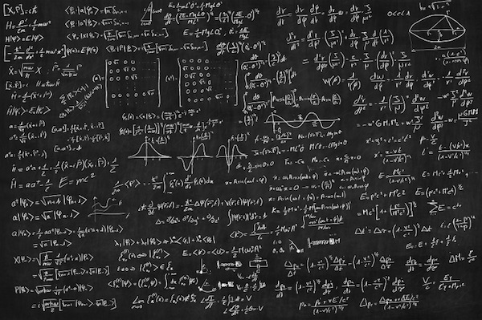
Numeracy: Foundations for
Language and Life
Kristin Klas and Kristin Perry
Hmong American Partnership

Slide 2
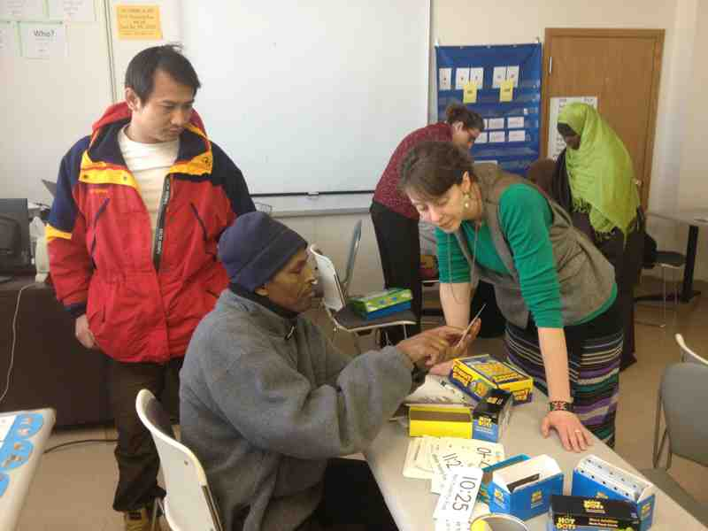
Who are we?

Slide 3
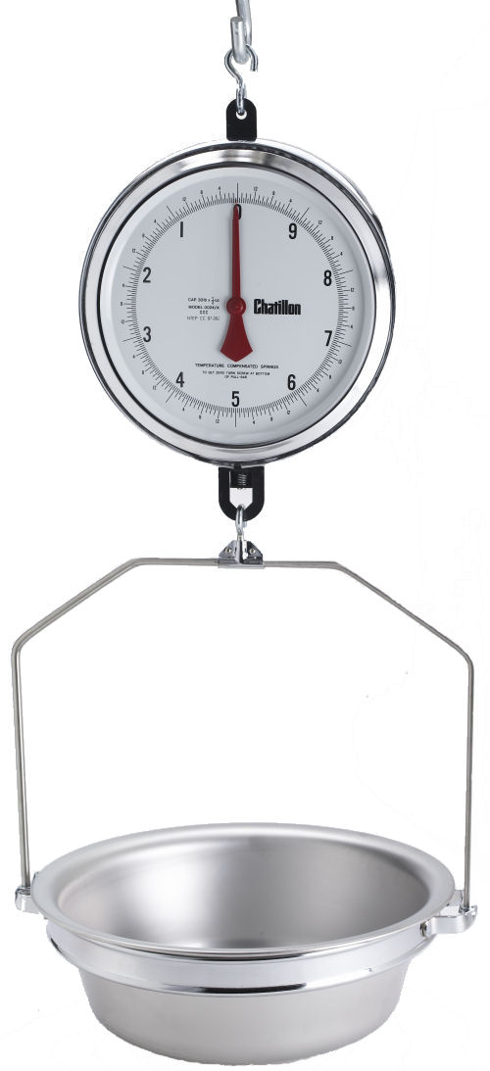
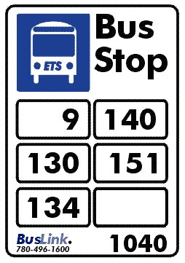
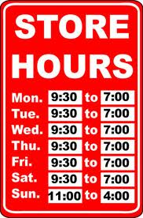
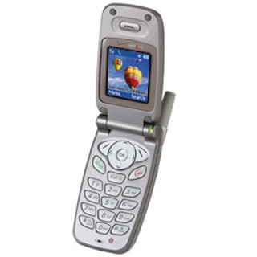
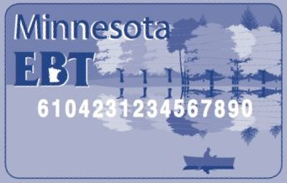
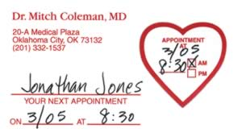
Why numeracy?

Slide 4
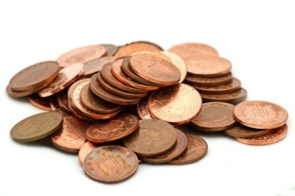
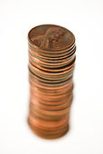
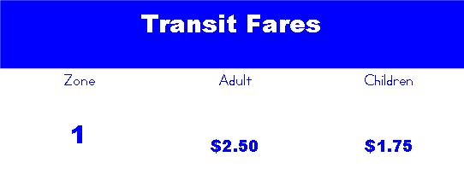
Intuitive | How much?
Concrete | These are the same. =
Pictoral | How much? $_____
Abstract | How much? 4 quarters = $_____ How many quarters? $1.75 = ___ quarters
Application
Communication | A: How much is bus fare? B: Bus fare is $2.50. A: 25¢, 50¢, . . .$2.25, $2.50. Here you go. B: Thank you.

Slide 5
Objective: Students will be able to pay the appropriate bus fare.
Manipulatives/Items Needed: pennies, quarters, pictoral worksheet, abstract worksheet, bus fare sign, bus fare dialogue
Warm up/Review: Show a picture of someone getting on the bus. What is he/she doing?
Introduction: Do you take the bus?
Presentation: When designing the presentation of the lesson, use the levels of knowing math:
Intuitive: Have students count out different amounts of money with pennies. They might group them to count faster. Observe the strategies they already use.
Concrete: Show students that a group of 25 pennies is the same as 1 quarter. Now have students count amounts of money in pennies and quarters, compare. Practice counting by 25s and then count only in quarters.
Pictoral: Let students practice finding the correct amount of money using a worksheet with pictures of quarters. (math-aids.com)
Abstract: Let students practice finding the correct amount of money with a worksheet styled like the CASAS test.
Application: Show students a bus fare list from the local transit organization. Have students count out the correct amount of change for different amounts. This should be easy by now.
Communication: Students practice a dialogue using the L2 where they ask the bus driver how much the fare is and count out the correct change.
Extension: Ask students to ask how much bus fare is and count it on the bus when they go home. Have them report back the next day.

Slide 6
numeracyforlife.weebly.com

